Slide 1
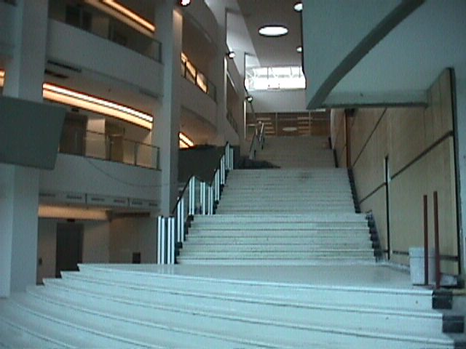

PROJECT CONSULTING GROUP INC.
Project and Construction Management services
General Contractors
42-66 SW 153rd Place
Miami, Florida 33185
Tel. (305) 485-9314
Fax (305) 485-0113
www.project-cg.com
davidsierra@project-cg.com

Slide 2
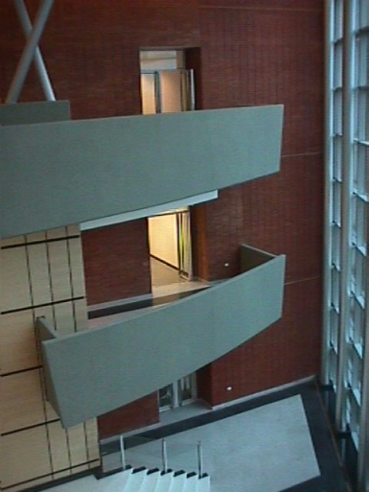
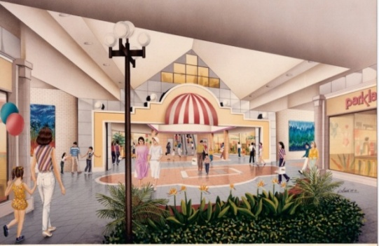
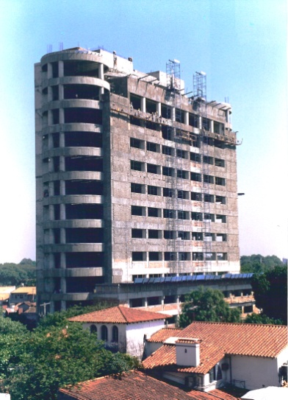
MISION STATEMENT AND GOAL
Project Consulting Group is prepared to provide expert Management skills and vast knowledge, using the most advance tools and techniques applicable to the construction industry; offering a wide range of experience and expertise to exceed all expectation from a project.
Our goal is to represent the owner, delivering their construction projects on time, on Budget, and without surprises, with most emphasis on cost, time, and quality, applying the strictest mitigation of risks.
PROJECT MANAGEMENT SCOPE OF SERVICES
Phase I - Project Planning
Manage the feasibility studies.
Review site selection and inspections.
Establish Design and Engineering teams.
Develop Project Master Schedule.
Preliminary budget preparation.
Manage the programming process.
Set project performance criteria.
Phase II – Design Management
Represent Client during design process.
Definition of physical requirements.
Coordination of the Design team.
Review schematic design with client.
Monitor Design Development.
Review design development with client.
Budget preparation and Financial analysis.
Update Master Schedule.
Manage construction documents production.
Identify municipal permit process.
Value Engineering.

Slide 3
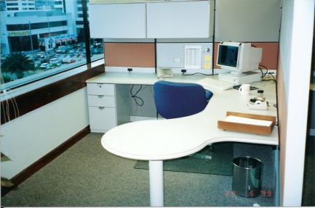
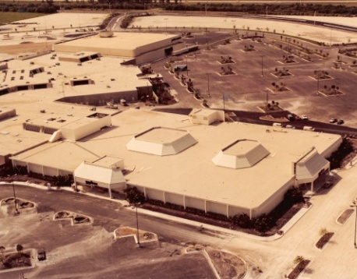
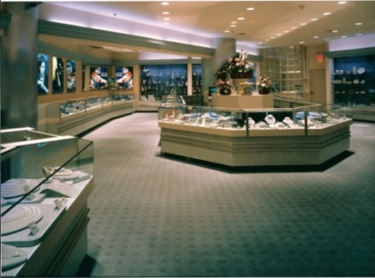
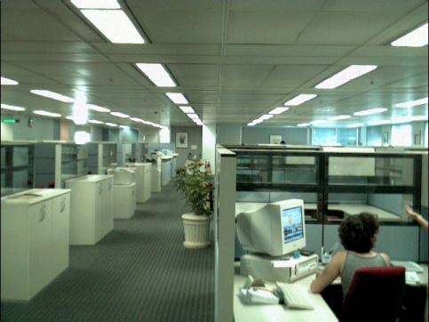
Phase III - Construction Management
Represent client during construction phase.
Develop Project organization.
Qualify, bid, and select General Contractor.
Negotiate General Contractors contract.
Sub-Contractor’s selection and negotiations.
Implement the project Master Schedule.
Manage the procurement process.
Administration of the construction contracts.
Construction Inspections and Monitoring.
Assist general contractor on submission of
Municipal permits and applications.
Attend and chair regular project meetings.
Manage the Construction process.
Coordinate all vendors.
Manage and implement Quality control.
Issue monthly progress reports.
Review progress payments.
Monitor and control construction costs.
Change orders Management.
Manage the Construction schedule .
Mediate and solve construction conflicts
that may occur.
Ensure completion of punch list.
Manage construction contracts close-out.
Phase IV- Post Construction
Monitor the installation of Furniture,
fixtures and equipment.
Relocation Assistance.
Systems star-up support.
Manage the Commissioning process.
Manage the Physical and Financial Closing.
Assist Contractor on obtaining a
Certificate of Occupancy.

Slide 4
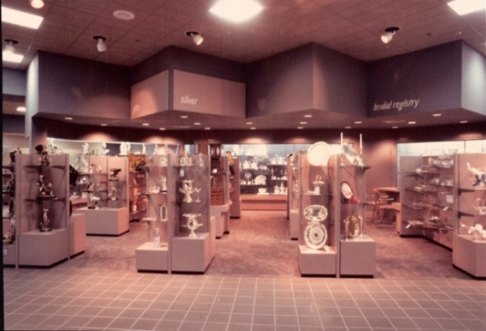
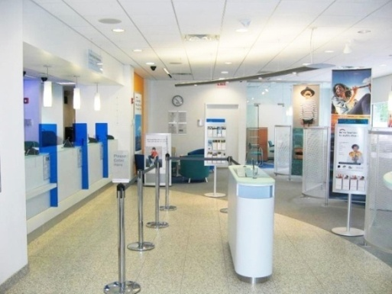
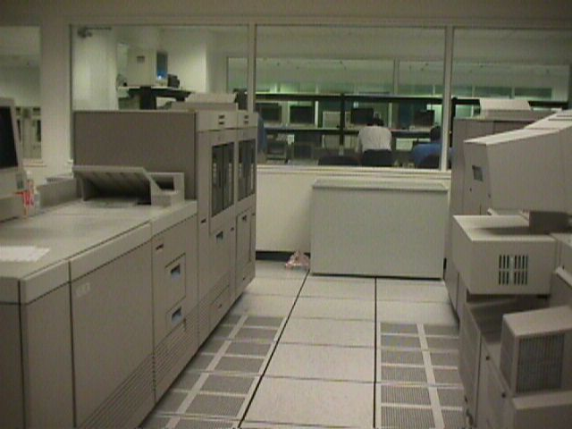
EXPERTISE
Over 40 years experience in the
following fields:
Financial Institutions.
Corporate Headquarters.
Warehouses.
Data Centers.
Shopping Centers.
Department Stores.
Tenant Improvements.
Retail banking.
ADDED VALUE
Reduce Construction costs
Increase project efficiency
Reduce construction time
Improve Project Quality
ADVANTAGES
Early Project Management involvement in a construction job allows better definition of the project’s scope, budget and financial planning, Master Schedule preparation, and performance benchmarking .
The opportunity of costs savings are highest during the initial feasibility and Design stages, as requirements are been defined.
Most problems found during construction are created by a failure to address them at some point in the early stages of the project; corrections made during the construction stage are extremely costly, time consuming, and disruptive.

Slide 5
BIOGRAPHY
Mr. David Sierra is a Senior Executive with over 30 years of Construction Management and Architectural experience, with the bulk of his Career involved in Project Management.
For the last 14 years, he worked at Citigroup, Inc. as a Senior Vice President, Regional Project Management Director, where he led, developed and implemented the processes surrounding the planning, coordination, execution and monitoring of all architectural and construction infrastructure projects within the Latin America Region.
Prior to joining Citigroup, Mr. Sierra, for over 16 years directed the Store Planning and Construction divisions for a variety of multinational corporations in the retail industry.
Major accomplishments
Citigroup Inc., Miami, Florida.
Directly managed the most complex Regional Headquarter and Data Center facilities projects. Successfully completed on-time and under budget Corporate Headquarter consolidations exceeding 2M square feet, $500M of capital expenditure, and around 20K employee relocations in: Argentina, Chile, Bolivia, Brazil, Venezuela, Dominican Republic, Paraguay, Peru, Uruguay, Ecuador, Costa Rica, Puerto Rico, Mexico, Guatemala, Colombia, Panama, and Jamaica.
Saved over 20% in costs, and achieved the most efficient office buildings in the region, by developing and implementing project processes, including efficient and flexible office space plans and workstation standards.
Negotiated, and implemented regional alliances with major global manufacturers and suppliers to leverage corporate agreements for furniture, construction equipment and materials, obtaining an average savings of 30% over local pricing.
Competently managed the planning and execution of re-branding roughly 700 branches and 150 office buildings.
Executive member of several steering committees for the development and implementation of Global corporate processes, and procedures.
Developed new branch design guidelines for the region, overseeing and monitoring the construction, and opening of around 250 Citibank’s retail branches a year.
Obtained 42% space reduction, and 32% operational expense savings through AWS (alternative workplace solutions) on real estate, by creating and implementing a pilot program for flexible corporate office space environment.
L. Lurias and son, Miami, Florida.
For a period of six years, directed the Construction and Store Planning Divisions, developing and implementing a new store design concept for 19 new store openings, bringing the company to a modern design, as well as the latest generation of systems and equipment.
Develop and implemented new store fixtures and merchandising displays standards.
Federated Department Stores (Burdines), Miami, Florida.
For over five years, directed the planning and construction of the: International Mall, Downtown, Mayfair, Market Place, Boca Raton, and Broward mega stores.
DAMAX Construction, Corp, Miami, Florida.
Directed the Project Management and Construction Divisions; effectively completed the construction of 200M square feet of office space, and 42 residences.
W.T. GRANTS, New York.
For over six years, as Chief Draftsman directed the Store planning drafting departments, producing lease and merchandize plans for the opening of over 90 stores a year.
Mr. Sierra received from Florida International University two Bachelor of Science degrees in: Architecture and Construction Management, as well as multiple Diplomas and Certificates on Computer programming and operations, also holds a General Contractors license from the State of Florida.

Slide 6
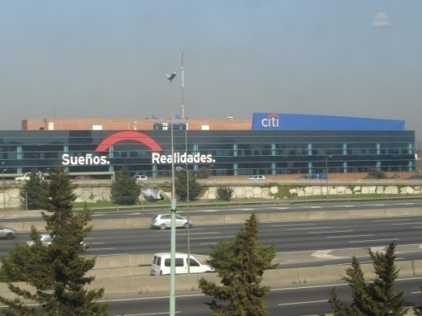
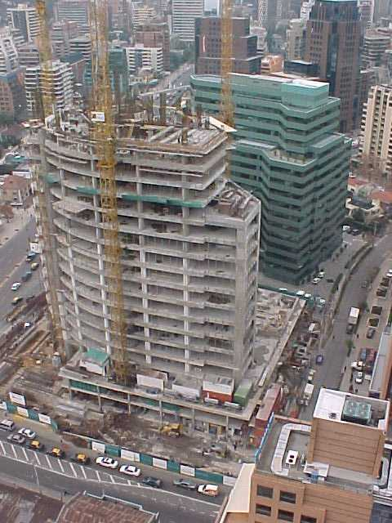
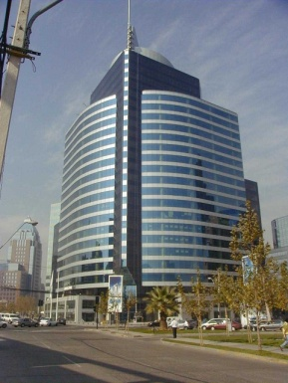
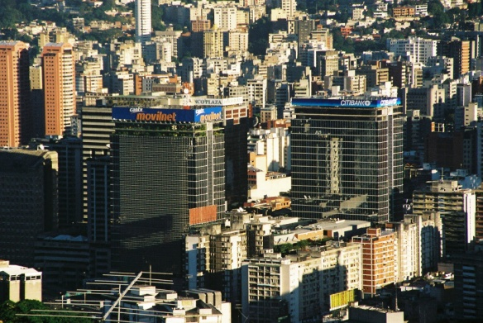
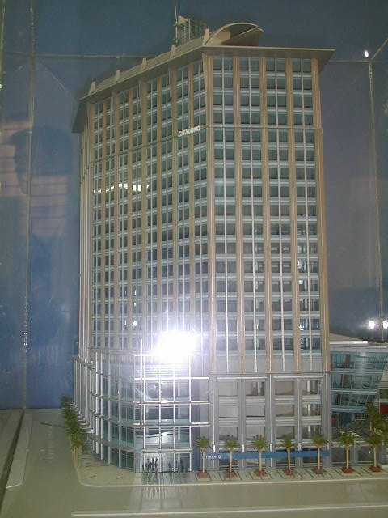
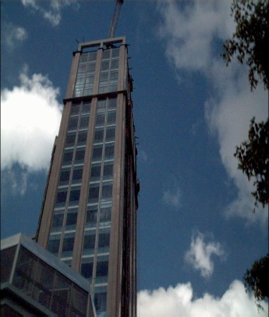
MAYOR SELECTED PROJECTS
CITIGROUP, Inc.
Buenos Aires, Argentina - Citicenter
Consumer Bank headquarters.
Project size: 450,000sf.
Project Value: $ 52M
Scope: Full Project Management services; from site selection to personnel moving in.
Consolidation of 11 building sites through the city, into one new headquarter campus type facility, relocating more than 2,100 employees.
Santiago, Chile – El Bosque
Consumer Bank headquarters.
Project size: 193,000sf
Project value: $ 36M
Scope: Full Project Management services; from site selection to personnel moving in.
Consolidation of 4 office sites through the city, into one new building, relocating more than 1,300 employees.
Caracas, Venezuela – El Recreo
Corporate and Consumer Bank headquarters.
Project size: 180,000sf
Project value: $ 43M
Scope: Full Project Management services; from site selection to personnel moving in.
Relocation of the headquarter operations into a new building, housing more than 1,000 employees.
Santo Domingo, Dominican Republic – Acropolis
Corporate and Consumer Bank headquarters.
Project size: 77,000sf
Project value: $ 22M
Scope: Full Project Management services; from site selection to personnel moving in.
Relocation of the headquarter operations into a new building, housing more than 500 employees.

Slide 7
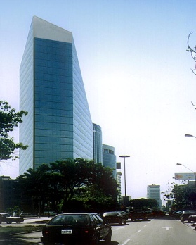
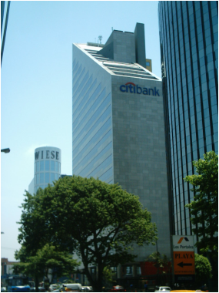
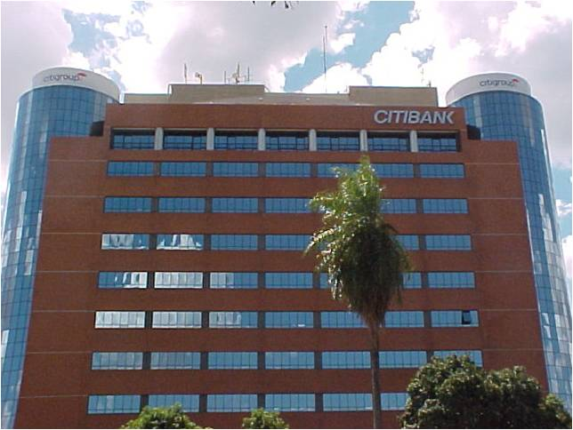
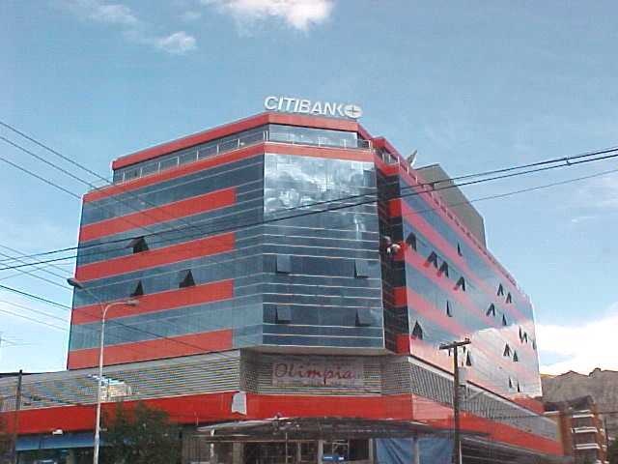
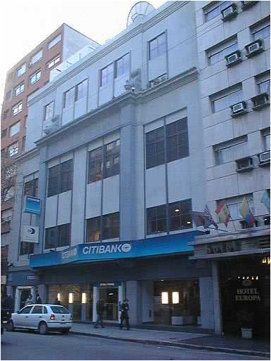
MAYOR SELECTED PROJECTS
CITIGROUP, Inc.
Lima, Peru – Chocavento
Corporate and consumer Bank headquarters.
Project size: 63,000sf
Project value: $ 20M
Scope: Full Project Management services; from site selection to personnel moving in.
Relocation of the headquarter operations into a new building, housing more than 550 employees.
Asuncion, Paraguay – Citicenter
Corporate Bank headquarters.
Project size: 75,000sf
Project value: $ 24M
Scope: Full Project Management services; from site selection to construction completion.
Relocation of the headquarter operations into a new building, housing more than 500 employees.
La Paz, Bolivia - Ketal Tower
Consumer and Corporate Bank headquarters
Project size: 36,000sf
Project value: $ 4.3M
Scope: Full Project Management services; from site selection to construction completion.
Relocation of the headquarter operations into a new building, housing around 210 employees.
Montevideo, Uruguay – California.
Consumer Bank headquarters.
Project size: 25,000sf - 225 seats
Project value: $ 1.2M
Scope: From Construction Documents to personnel moving in.
Relocation of the headquarter operations into a new building, housing around 180 employees.

Slide 8
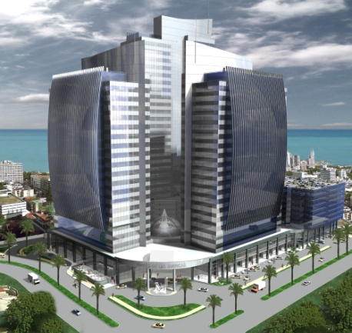
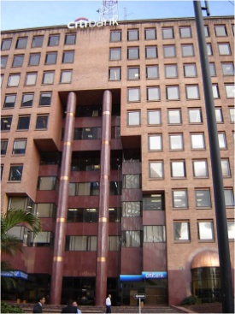
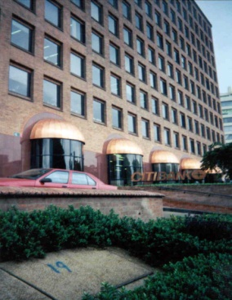
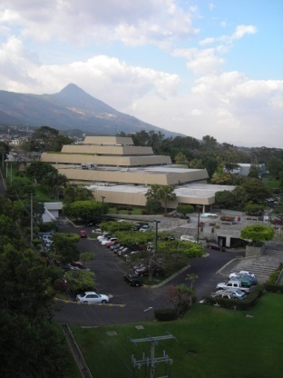
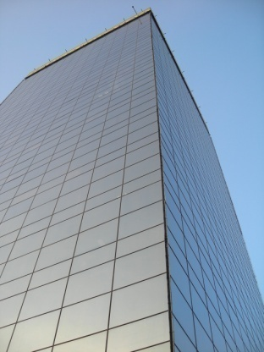
CITIGROUP (Continuation)
Panamá City, Panamá – Torre de las Américas
Corporate and Consumer Bank Headquarters
Project Size: 183,000sf. – 1,095 seats (Phase I).
Project Value: $ 24M
Scope: Feasibility study, site selection, Design Development and construction documents.
Consolidation of Banco Cuscatlan, Grupo Financiero Uno and Citigroup headquarter facilities into a new office building, housing more than 1,000 employees (project in progress).
Kingston, Jamaica – Hillcrest
Corporate Bank Headquarters
Project Size: 30,000sf
Project Value: $ 11.6M
Scope: Feasibility study, site selection, Design Development and construction documents.
Relocation of the headquarter office operations into a new building, relocating around 120 employees (project in progress).
Bogota, Colombia - Calle 100
Corporate and Consumer Bank Headquarter
Project Size: 310,000sf – 4,500 seats.
Project Value: $ 85M
Scope: Feasibility study and site selection.
Consolidation of 6 office sites through the city, into one new building, relocating more than 4,500 employees (project in progress).
Central América
Guatemala, Costa Rica, Honduras, Panamá, El Salvador.
Project Size: Over 3,000,000sf
Scope: Feasibility studies.
Acquisitions and Consolidations of Banco Cuscatlan, Grupo Financiero Uno, and Citigroup operation facilities into a new headquarters building, affecting more than 670 properties, and over 20K employees (project in progress).

Slide 9
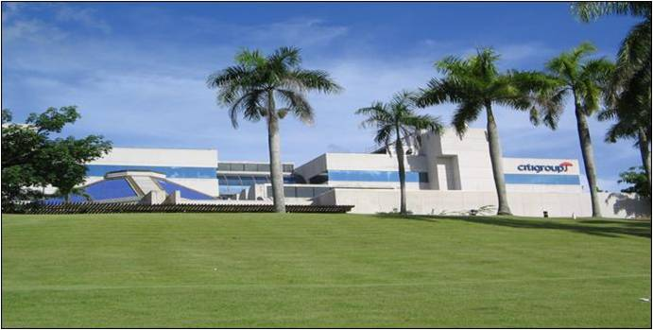
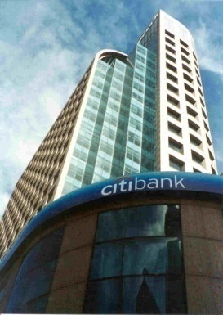
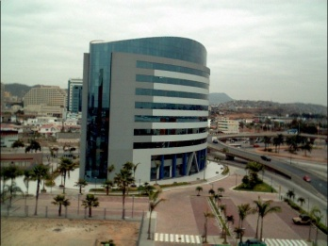
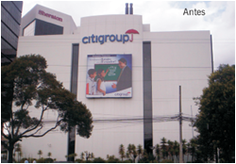
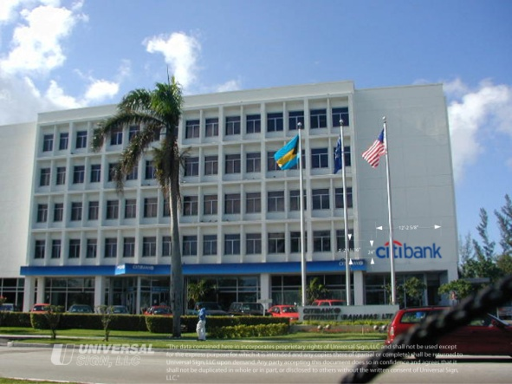
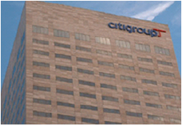
CITIGROUP ( Continuation)
San Juan, Puerto Rico – Citibank center
Corporate and Consumer Bank Headquarter.
Project size: 123,000sf
Project value: $5.6M
Scope: Co direction of Project Management services; from Design Development to personnel relocation.
Major Building re-stacking affecting more than 900 employees.
Sao Paulo, Brazil – Citicorp center
Corporate and Consumer bank headquarters
Project size: 275,000sf
Project value: $7.5M
Scope: Co direction of Project Management services, from Design Development to personnel relocation.
Major Building re-stacking and relocations affecting more than 4,000 employees.
Quito, Ecuador – Citigroup Building.
Project size: 20,000sf – 170 seats
Project value: $1.1M

Slide 10
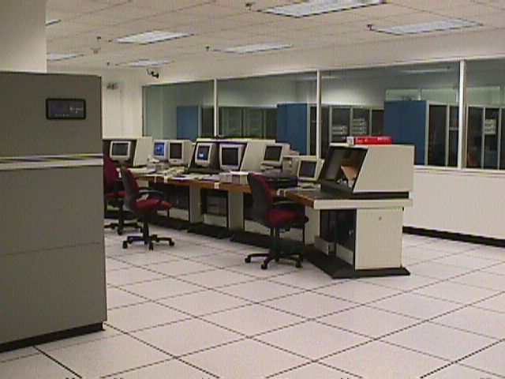
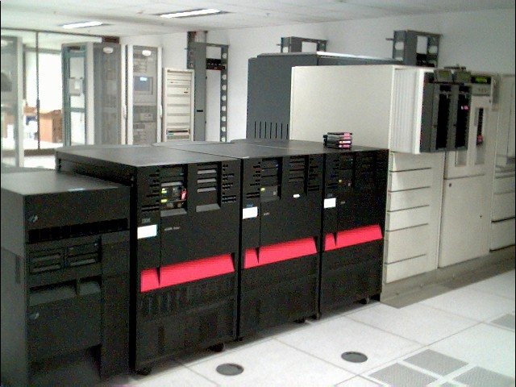
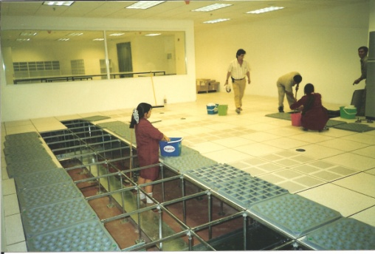
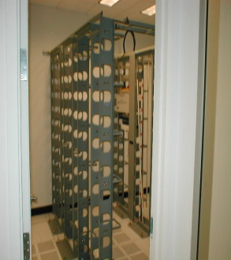
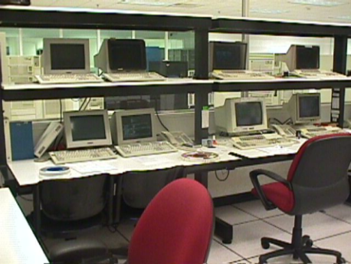
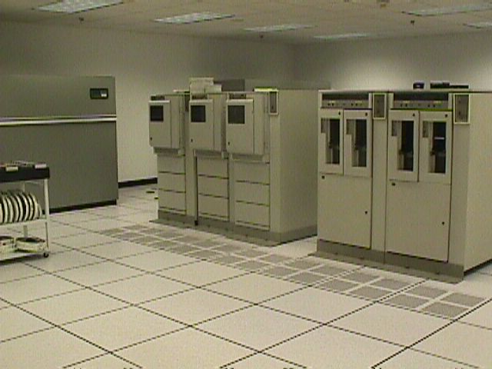
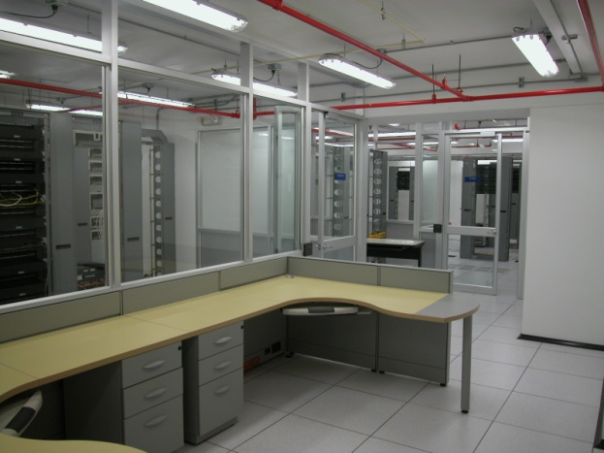
DATA CENTERS
Argentina: 16,000sf. Paraguay: 5,000sf.
Bolivia: 3,500sf. Brazil: 14,000sf.
Uruguay: 6,000sf. Chile: 12,000sf.
Colombia: 8,500sf. Dominican Republic: 3,500sf.
Peru: 5,000sf. Venezuela: 6,000sf.

Slide 11
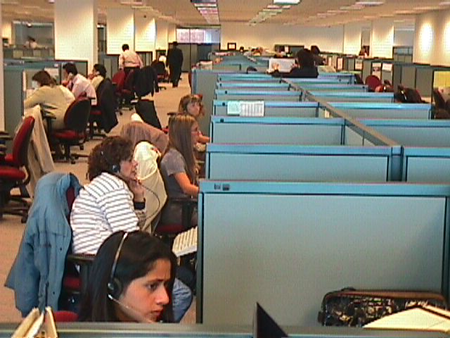
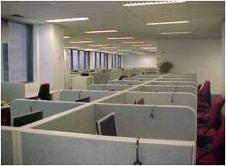
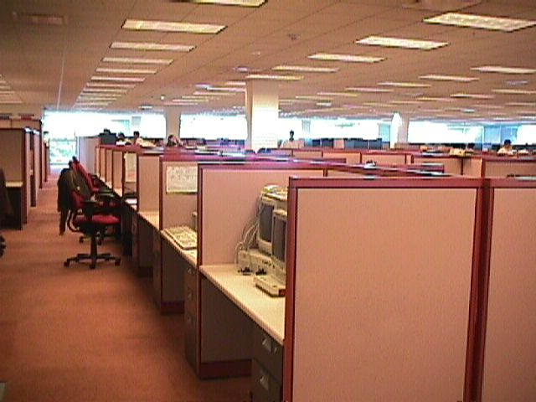
MAJOR CALL CENTERS
Argentina: 1,200 seats
Colombia: 700 seats
Mexico: 800 seats
Puerto Rico: 600 seats

Slide 12
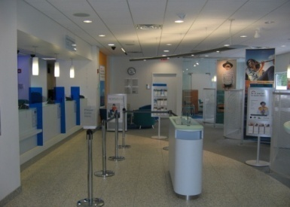
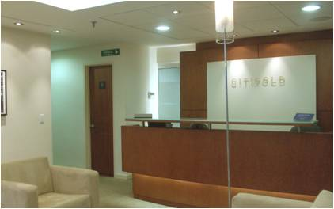
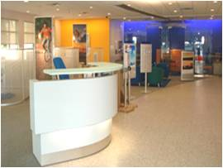
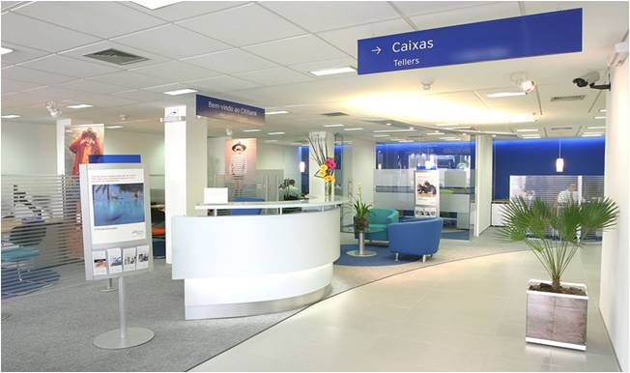
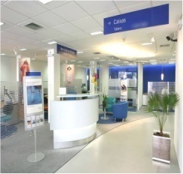
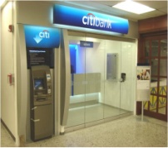
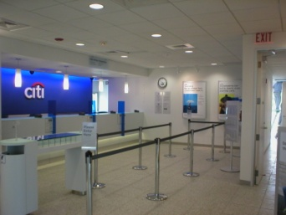





CITIBANK - BRANCHES
Open around 325 branches throughout 22 Countries in South and Central America, Mexico, The Caribbean and South Florida

Slide 13










REBRANDING
Implementation of two Citigroup’s rebranding programs (2002 and 2007) throughout 22 countries in Latin America, the Caribbean, and South Florida.
Over 650 facilities, from Headquarter office buildings to retail branches.

Slide 14





OTHER PROJECTS
Costa Rica: New headquarter. - 18,000sf. Offices relocations.
Florida: Citiplan consolidation. – 280,000sf. Feasibility study.
Guatemala: New headquarter – 29,000sf. Office relocations.
México: Headquarter remodel – 230,000sf. Office remodeling.
RETAIL AND HOUSING
L. Lurias &Son: Open 19 new department stores in the State of Florida.
Develop “Modelia Townhouses” project in Hialeah, Florida

Slide 15
REFERENCES
“I worked as a peer of David's for the past 10+ years. Consistently during that time he continued to impress me with his extensive knowledge and experience in the Construction Industry. He is a very effective Senior Project Manager, and he is also an effective leader of Project Managers. He continuously analyzes projects (from conception through completion) to keep the costs as low as possible balanced with high quality and with an eye toward meeting set deadlines. In an industry that is sometimes known for unsavory dealings, David is refreshingly honest and has high integrity for doing the right thing. If given the opportunity, I would work with David again!”
Sigrid Feder , Sr. Vice President / Region Operations Head - LatAm Realty Services , Citi group
“David was the Regional PM Head, and worked for me for over 10 years. David is an expert at Project Management, and always performed his duties with diligence and demanded high performance on all projects. He was an excellent officer upon whom I completely relied. Self starter who never failed.”
Michael Steadman , EVP , Citigroup
“I had the privilege to work for David during his tenure in Buenos Aires with Citibank. During all the years that we have known each other, his high professional standards and in thorough knowledge became a exceptional assets for his peers and to the company. I highly recommend David as a colleague and as a friend to any company that wishes to hire him as part of their management group.
Guido Conegliano , Managing Partner , MG Consultant LLC
“David J was a detailed oriented management head, who maintained a high level of enthusiasm and focus throughout the course of his projects. He was a positive motivator for his team, and never lost sight of project objectives, schedule, and budget. He encouraged creativity for architectural project solutions, and was always willing to contribute ideas when called upon in the design development process.”
Dana Lodin , President , PN&L
“Good performance as Senior Project Manager leading the project & Construction development of Citicenter Building (Citibank Headquarter) in Paraguay. (213M sq/ft)”
Castorino Rojas , Asset Manager , Citigroup

Slide 16
REFERENCES (Continuation)
“I had the pleasure of working with David Sierra on many branding and rebranding projects at Citi in south American countries during the course of three years. He is one of the most trusted and respected Professionals in the corporate realty services project management business. David is recognized throughout South, Central and North America multidisciplinary teams as a fully accomplished expert, an energetic, smart, and dedicated and highly results oriented professional and also as an unique team leader.”
Bia Monteiro , Brand Management Regional Director , Citigroup
“David and I worked together for more than 12 years in several major projects including construction and consolidation of office space for Citigroup. David has a broad experience and high skills in Project and Construction Management. In his role of Director of Project Management he provided guidelines and support to projects in all Latin America countries. David has the expertise and the flexibility to adapt to all different cultures and deliver a consistent high quality product to his customers. I hereby recommend David.”
Fernando Lerici , SLA Sub Region Head , Citi
“ David is a seasoned professional with ample experience in project management. As Project Management Head for Citi's Latin American cluster, he has directly handled - or supervised the handling of - hundreds of projects (big and small) throughout the region. He has a passion for detail without losing sight of the big picture.”
Gaston Sirito , SVP / Sub Region Head - Corporate Realty Services , Citi
“I have been a matrix report of David for 5 years and we implemented together important regional Projects. He is an excellent creative and results-oriented leader with extensive experience in the banking and corporate building architecture. David is well respected at all levels of the company in different countries and is clearly recognized as a subject matter expert. David is a very talented professional and I would work with him again if ever the chance arose.”
Gonzalo Zournadjian , Project Management Head_ VPR-Civil Engineer , CITI

